Slide 1

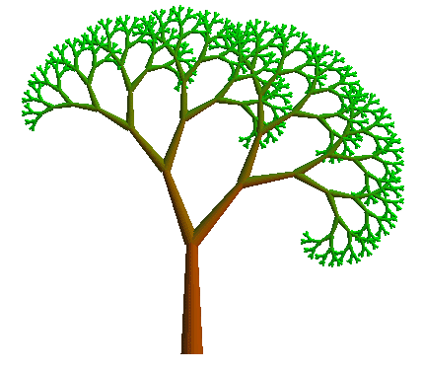
Dictionaries and Map Paths
Recursive pictures
Tuples: immutable sequences
Dictionaries: a new data type
Using a dictionary to compute routes in a map

Slide 2
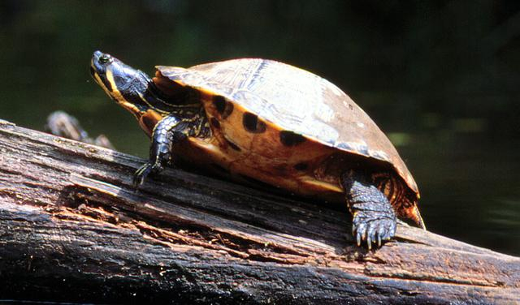

Turtle Graphics
forward(100)
right(90)

Slide 3
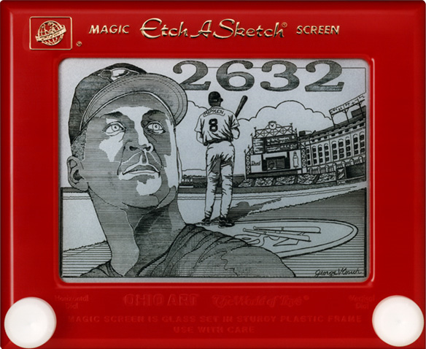
Etch-a-Sketch craziness…
No way this is real…
except that it is !

Slide 4
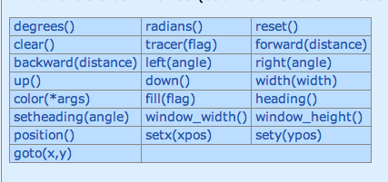
Turtle Graphics
>>> import turtle
>>> turtle.forward(50)
>>> turtle.right(90)
>>> turte.backward(50)

Slide 5
Fractals

Slide 6
Fractals

Slide 7
Fractals

Slide 8
Fractals

Slide 9
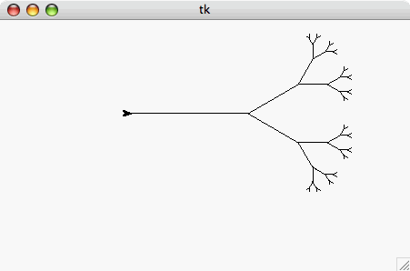
“I wonder about Trees” – Robert Frost
“We wonder about Robert Frost” - Trees
>>> svTree(128, 6)
Notes:
Side view of tree

Slide 10
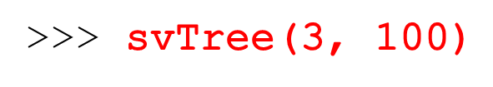
recursion level
trunk length

Slide 11
recursion level
trunk length
100 long!

Slide 12
recursion level
trunk length
>>> svTree(3, 100)
svTree(2, 50)
100 long!

Slide 13
recursion level
trunk length
>>> svTree(3, 100)
svTree(2, 50)
100 long!

Slide 14
recursion level
trunk length
>>> svTree(3, 100)
svTree(1, 25)
svTree(2, 50)
100 long!

Slide 15
recursion level
trunk length
>>> svTree(3, 100)
svTree(1, 25)
svTree(2, 50)
100 long!

Slide 16
recursion level
trunk length
>>> svTree(3, 100)
svTree(1, 25)
svTree(2, 50)
100 long!

Slide 17
recursion level
trunk length
>>> svTree(3, 100)
svTree(1, 25)
svTree(2, 50)
100 long!

Slide 18
recursion level
trunk length
>>> svTree(3, 100)
svTree(1, 25)
svTree(2, 50)
100 long!

Slide 19
recursion level
trunk length
>>> svTree(3, 100)
svTree(1, 25)
svTree(2, 50)
100 long!

Slide 20
recursion level
trunk length
>>> svTree(3, 100)
svTree(1, 25)
svTree(2, 50)
100 long!

Slide 21
recursion level
trunk length
>>> svTree(3, 100)
svTree(1, 25)
svTree(2, 50)
100 long!

Slide 22
recursion level
trunk length
>>> svTree(3, 100)
svTree(1, 25)
svTree(2, 50)
100 long!

Slide 23
recursion level
trunk length
>>> svTree(3, 100)
svTree(1, 25)
svTree(2, 50)
100 long!

Slide 24
recursion level
trunk length
>>> svTree(3, 100)
svTree(1, 25)
svTree(2, 50)
100 long!

Slide 25
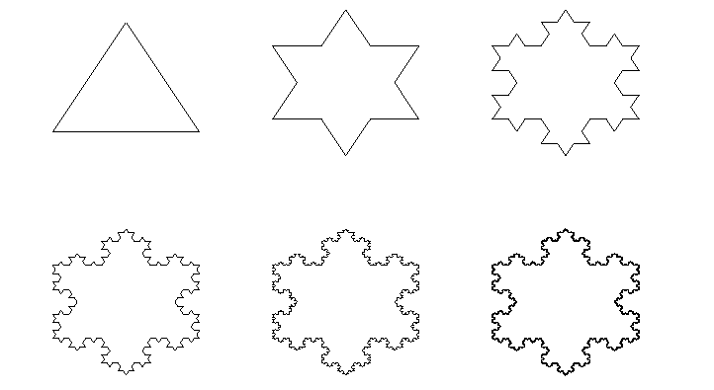
SnowFlake Fractals
The Koch Snowflake Fractal:
level 0
level 1
level 2
level 3
level 4
level 5

Slide 26
Snowflake Fractals
The Koch Snowflake Fractal:
level 0
level 1
level 2
level 3
level 4
level 5
level 0
1/3
1/3
level 1
1/3
1/3
1/3

Slide 27

And now for something completely different…
(…or at least it will seem different until we see that it’s not!)

Slide 28
Tuples (“immutable lists”)
>>> foo = (42, 'hello', (5, 'spam'), 'penguin')
>>> foo
(42, 'hello', (5, 'spam'), 'penguin')
>>> foo[0]
42
>>> foo[-1]
'penguin'
>>> foo[0:2]
(42, 'hello')
>>> foo[0:1]
(42,)

Slide 29
Tuples (“immutable lists”)
>>> foo = (42, 'hello', (5, 'spam'), 'penguin')
>>> foo
(42, 'hello', (5, 'spam'), 'penguin')
>>> foo[0]
42
>>> foo[-1]
'penguin'
>>> foo[0:2]
(42, 'hello')
>>> foo[0:1]
(42,)
>>> foo[0] = 100
BARF!!! (that’s California-speak for ‘error’)

Slide 30
Dictionaries
>>> D = {}
>>> D[“Ran”]= “spam”
>>> D[“Zach”]= “donuts”
>>> D[“Alien”]= 42
>>> D[“Ran”]
'spam'
>>> D[“Alien”]
42
>>> D[“Napoleon Dynamite”]
BARF!
“Ran”, “Zach”, and “Alien” are called the
“keys” in the dictionary. Any immutable
object can be a key.

Slide 31
Dictionaries
>>> D = {}
>>> D[“Ran”]= “spam”
>>> D[“Zach”]= “donuts”
>>> D[“Alien”]= 42
>>> D[“Ran”]
'spam'
>>> D[“Alien”]
42
>>> D[“Napoleon Dynamite”]
BARF!
>>> D
{ ‘Ran’: ‘spam’, ‘Zach’: ‘donuts’, ‘Alien’ : 42 }

Slide 32
Dictionaries - summary
A dictionary associates values with keys.
D = {} # create an empty dictionary
D[k]= v # make key k have value v
# (replace old value if k already in D)
D[k] # get value under key k
k in D # whether k is a key in D
Example: {‘cat’:3, ‘avatar’:1, ‘sprite’:42}
v can be any value
k must be an immutable type (string, int,
tuple of immutables)

Slide 33
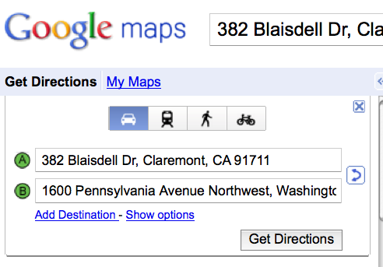
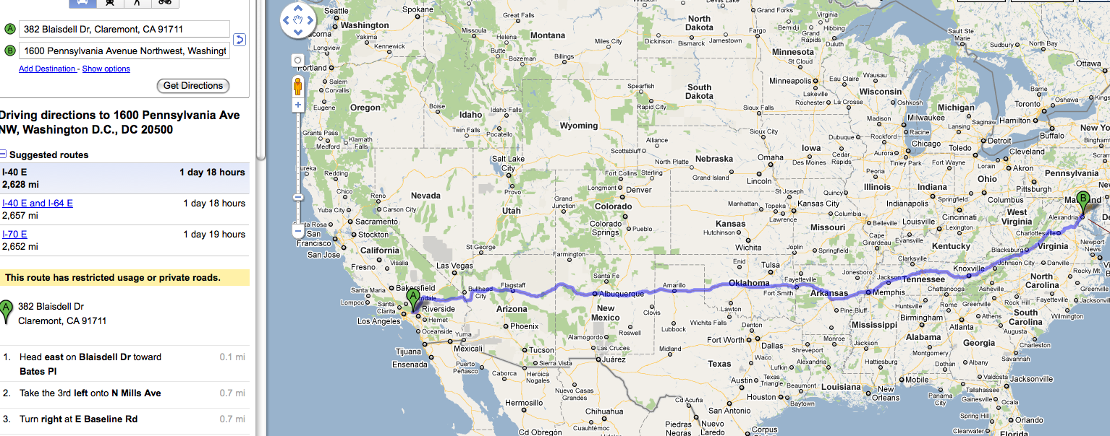
Finding Shortest Paths

Slide 34
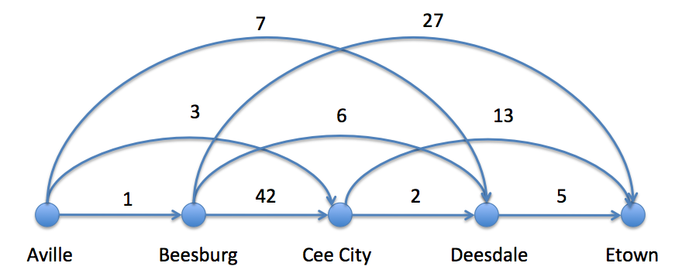

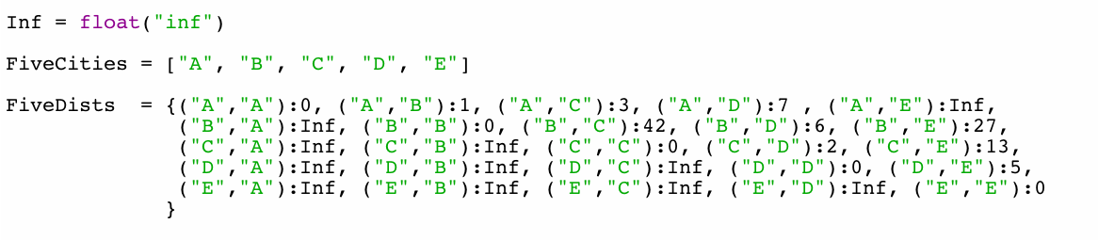
Giigle maps
>>> FiveDists[ (“B”, “C”) ]
42

Slide 35
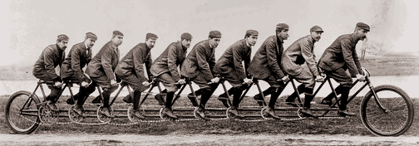
Sometimes we need to make more than 2 recursive calls!

Slide 36

Giigle maps
7
27
3
6
13
1
42
2
5
Aville
Beesburg
Cee City
Deesdale
Etown
All roads point east!
Shortest path?
Is greed good?
How does the use-it-or-lose-it idea get used here?

Slide 37
>>> shortestPath (FiveCities, FiveDists)
10
>>> shortestPath ([“C”, “D”, “E”], FiveDists)
7
>>> shortestPath ([“E”], FiveDists)
0

Slide 38
def shortestPath (Cities, Distances):
‘’’ returns the length of the shortest path
from the leftmost to the rightmost city in
the Cities list.’’’
if BLAH: return BLAH BLAH
else: return BLAH BLAH BLAH
Just two lines of code!!!
It’s fitting that
map gets used
here!

Slide 39
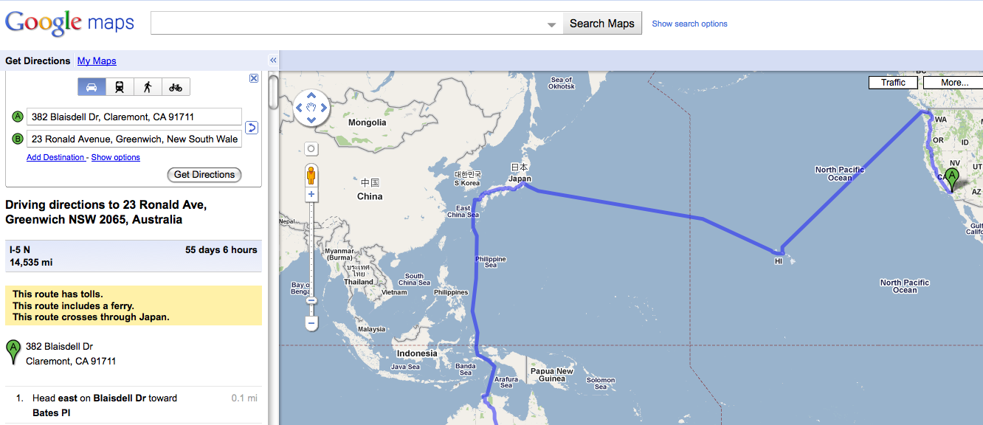
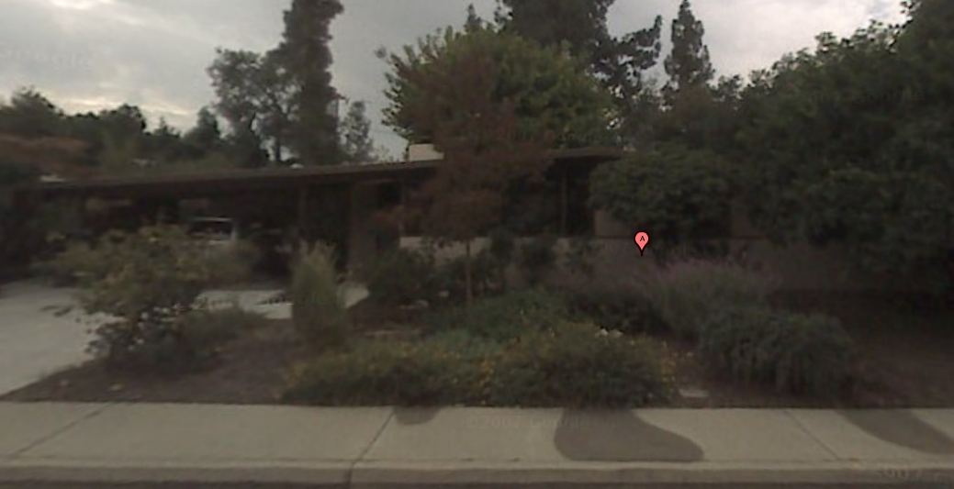
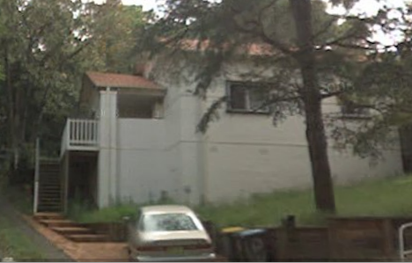
Take a look at these
Instructions!

Slide 40
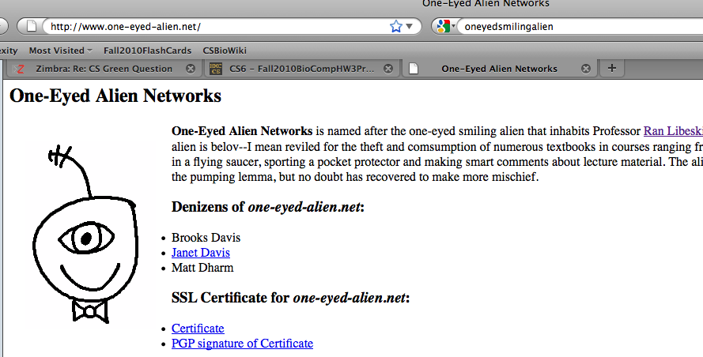
The Recursion Theorem
Does it state that recursion is the secret to all happiness?

Slide 41
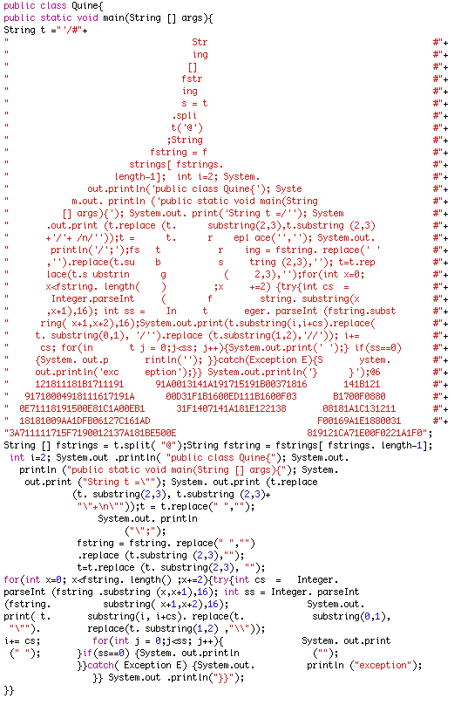
Courtesy of Richard Bowen

